Slide 1

Practices of Institutions Performing Routine Screening for Lynch Syndrome: Data from the Lynch Syndrome Screening Network
Cecelia Bellcross, Debra Duquette, Heather Hampel, Kory Jasperson, Sarah Mange and the LSSN

Slide 2
Rationale for HNPCC/Lynch Syndrome Screening of Newly Diagnosed CRC
Common: ~ 3% of all CRC
Age/screening criteria miss 25% or more
Accurate methods (MSI/IHC) using easily accessible tumor tissue
Benefits of medical intervention
  Cascade testing of family members
  Surveillance/prevention
  CRC treatment decisions
Evidence of cost-effectiveness

Slide 3
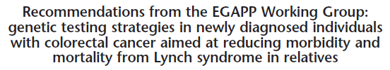
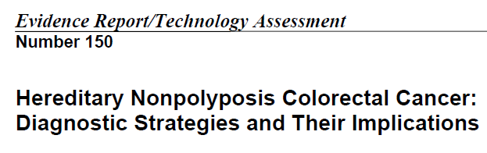
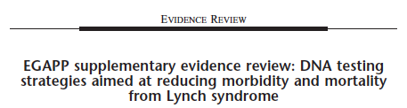
EGAPP Lynch Recommendation
Genetics in Medicine January 2009
GIM, 2009;1:35
May, 2007
www.ahrq.gov/downloads/pub/evidence/pdf/hnpcc/hnpcc.pdf
GIM, 2009;1:42

Slide 4

Healthy People 2020
Approved Genomics Objective (Developmental)
“Increase the proportion of persons with newly diagnosed colorectal cancer who receive genetic testing to identify Lynch syndrome”

Slide 5
Created in September 2011 with one-time funding from CDC Office of Public Health Genomics:
  Support for in-person meeting
  Seed funding for database
Founding Board of Directors from MI Dept of Community Health, Emory University, Huntsman Cancer Institute, The Ohio State University

Slide 6
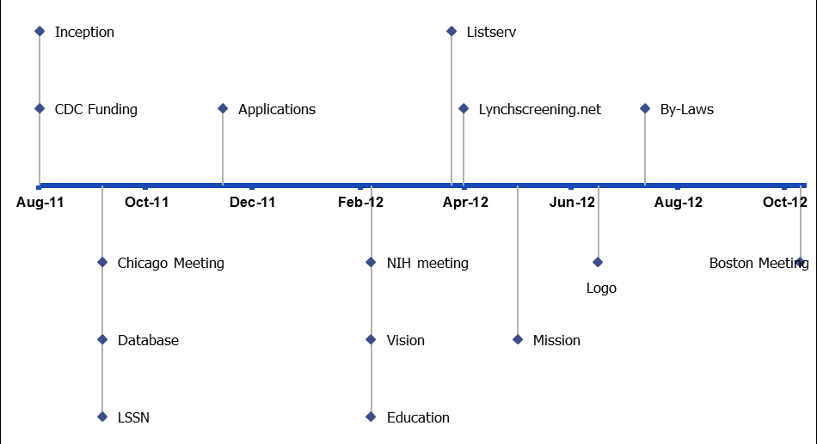

Slide 7
LSSN Vision and Mission
LSSN Vision:
  to reduce the cancer burden associated with Lynch syndrome.
LSSN Mission:
  to promote universal Lynch syndrome screening on all newly diagnosed colorectal and endometrial cancers; to facilitate the ability of institutions to implement appropriate screening by sharing resources, protocols and data through network collaboration; and to investigate universal screening for other Lynch syndrome related malignancies

Slide 8
Methods
Institutions were invited to participate in the LSSN via select professional organizations involved in cancer genetics.
Interested institutions completed an application that included information on:
  existing screening protocols
  plans for future implementation
  screening for endometrial/other LS cancers
  changes in number of cancers screened over time
  willingness to contribute to a shared online database

Slide 9
Application Data
91 Institutions submitted applications to LSSN between 12/2011 & 6/2012
  52 (57%) institutions currently providing routine tumor screening for Lynch syndrome on all or subset of colorectal cancers
  10 (11%) additional institutions planning to implement within 6-12 months
  17 (19%) were in the process of or planning to develop protocols for routine screening
Notes:
The remainder of applicants were involved in the care of patients with LS-related cancers, interested in resources or research regarding routine screening, or a government agency/professional society with interest in universal screening.

Slide 10
Application Data
62 Institutions with existing protocols for routine screening
  35 (56%) screen all newly diagnosed colorectal cancers (truly universal)
  27 (44%) screen subset determined by age cut off or other selection criteria
92% reported EGAPP recs had justified, altered or supported LS screening protocols

Slide 11
Date Screening Initiated/Planned

Slide 12
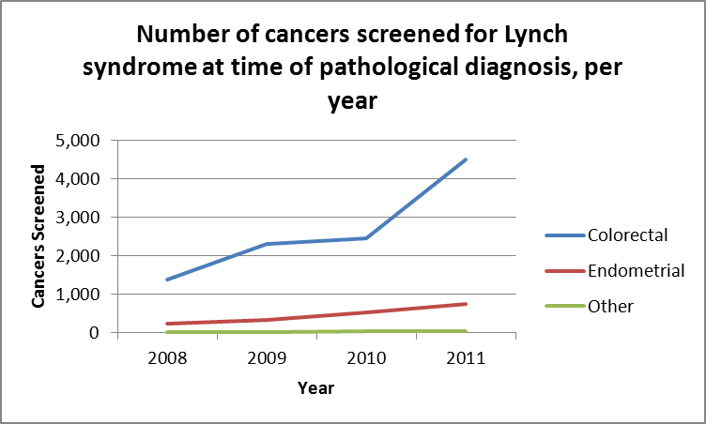
4516
750
44

Slide 13
Screening Protocols
%
*hypermethylation

Slide 14
Additional Findings
98% involved genetics in some aspect of their protocol
  44% genetics reviews all screens and initiates all follow-up
Data Entry (online database) – 84 responses
  51% willing
  49% unsure

Slide 15
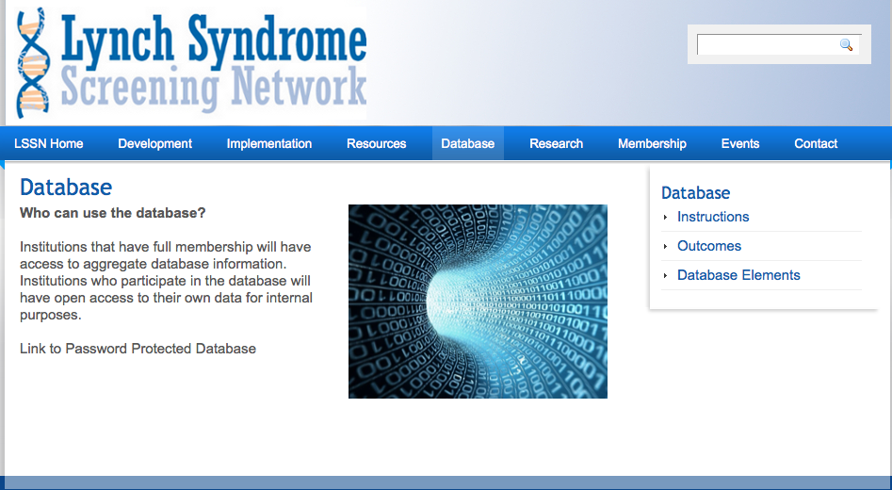
www.lynchscreening.net

