Slide 1
Vision/Mission, By-Laws, and Current Status
Kory Jasperson, MS, CGC
October 27, 2012
Boston, MA

Slide 2
Overview
Vision/Mission
By-laws
Current membership/partnership
Benefits
List of Institutions

Slide 3
Vision & Mission
Vision: Reduce the cancer burden associated with Lynch syndrome
Mission: Promote universal Lynch syndrome screening on all newly diagnosed colorectal and endometrial cancers; to facilitate the ability of institutions to implement appropriate screening by sharing resources, protocols and data through network collaboration; and to investigate universal screening for other Lynch syndrome related malignancies

Slide 4
Members & Partners
Membership
  Full member
  Affiliate member
Partnership
  Official partner
Membership and partnership is not open to individuals
For-profit laboratories are not eligible

Slide 5
Members & Partners
Full Membership
Institutions (hospitals, clinics, and academic medical centers) currently performing routine* tumor testing on colorectal cancers and/or endometrial cancers; AND
Commitment to enter data (outlined by the research guidelines) regularly into the LSSN database for surveillance and/or research purposes; AND
Institutional review board (IRB) approval (either obtained or in process) to enter data (outlined by the research guidelines) into the LSSN database; AND
A genetic counselor or other qualified healthcare provider† trained in providing cancer genetic services is required to be at the institution; AND
A genetic counselor or other qualified healthcare provider† must have access (either through clinical responsibilities and/or IRB approval) to both normal and abnormal routine* tumor testing results
Affiliate Membership
Institutions (hospitals, clinics, and academic medical centers) performing routine testing*, but not meeting all criteria for full membership; OR
Institutions interested in starting routine testing*
Official Partners
Organizations interested in promoting routine testing* on all newly diagnosed colorectal and/or endometrial cancers that fall into the following categories:
  Federal/state agencies
  Professional societies
  Patient support/advocacy groups
  Laboratories (non-profit only) or companies
*Automatic tumor testing to evaluate for Lynch syndrome at the time of cancer diagnosis/surgery

Slide 6
Genetic counselor/qualified healthcare provider
An American Board of Genetic Counseling or American Board of Medical Genetics board-certified /board-eligible or (in some states) a licensed genetic counselor
An American College of Medical Genetics physician board certified in medical genetics
A Genetics Clinical Nurse or an Advanced Practice Nurse in Genetics, credentialed through the Genetics Nursing Credentialing Commission. Credentialing is obtained through successful completion of a professional portfolio review process.
An advanced practice oncology nurse who is prepared at the graduate level (master or doctorate) with specialized education in cancer genetics and hereditary cancer predisposition syndromes (Specialized training should be ongoing; educational seminars offered by commercial laboratories about how to perform genetic testing are not considered adequate training for cancer risk assessment and genetic counseling); certification by the Oncology Nursing Certification Corporation is preferred.
A board-certified physician with experience in cancer genetics (defined as providing cancer risk assessment on a regular basis)

Slide 7
Members & Partners
Full Membership
Institutions (hospitals, clinics, and academic medical centers) currently performing routine* tumor testing on colorectal cancers and/or endometrial cancers; AND
Commitment to enter data (outlined by the research guidelines) regularly into the LSSN database for surveillance and/or research purposes; AND
Institutional review board (IRB) approval (either obtained or in process) to enter data (outlined by the research guidelines) into the LSSN database; AND
A genetic counselor or other qualified healthcare provider† trained in providing cancer genetic services is required to be at the institution; AND
A genetic counselor or other qualified healthcare provider† must have access (either through clinical responsibilities and/or IRB approval) to both normal and abnormal routine* tumor testing results
Affiliate Membership
Institutions (hospitals, clinics, and academic medical centers) performing routine testing*, but not meeting all criteria for full membership; OR
Institutions interested in starting routine testing*
Official Partners
Organizations interested in promoting routine testing* on all newly diagnosed colorectal and/or endometrial cancers that fall into the following categories:
  Federal/state agencies
  Professional societies
  Patient support/advocacy groups
  Laboratories (non-profit only) or companies
*Automatic tumor testing to evaluate for Lynch syndrome at the time of cancer diagnosis/surgery

Slide 8
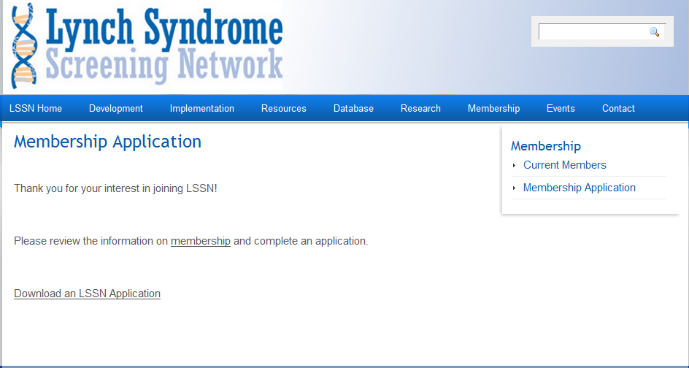
Applications

Slide 9
Applications
Members must reapply annually
  New application coming soon for 2013
Official partner status is indefinite
Current status (12/2011 to 10/2012)
  55 full members
  31 affiliate members
  8 partners
  2 in process

Slide 10
Certificate

Slide 11
Benefits
Members/Partners
  Listserv
  Meetings
  Networking
  Existing protocols/educational materials
  Research
Full members
  Access to aggregate data
  Open access to their own data
  Funding opportunities
  Authorship for representatives

Slide 12
Research Protocol
Research Proposal
Review (BOD/Research Committee)
Data Access
Manuscript Review (Research Committee/BOD)
Publication

Slide 13
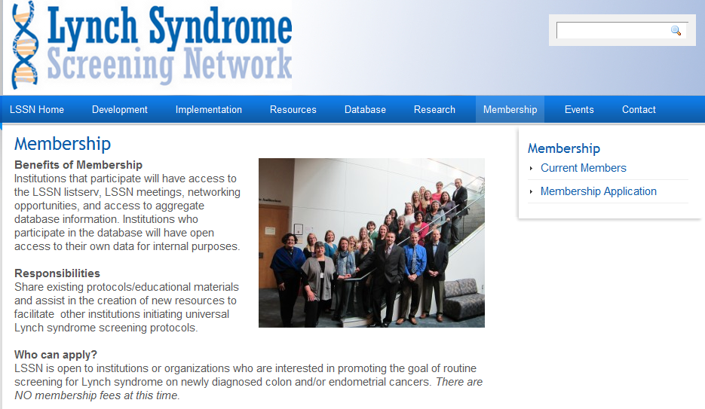
List of Institutions

