Slide 1
LSSN MISSION IDEAS
Why we are Here? (Our Purpose)

Slide 2
LSSN DRAFT MISSION
Our mission is to promote universal Lynch syndrome screening on all newly diagnosed colorectal cancers and other Lynch syndrome related malignancies and to facilitate the ability of institutions to initiate, carryout and sustain appropriate screening by creating new resources and sharing existing materials, protocols and data through network collaboration.

Slide 3
Check OUR LSSN MISSION
There is a clear sense of why we are a partnership
We all agree on the mission
All members clearly understand mission
Members have a high level of commitment to mission
We plan to keep our mission visible to help keep us focused
There is a clear sense of how our work as a partner fits into the mission

Slide 4
LSSN VISION IDEAS
What is our desired impact?

Slide 5
LSSN DRAFT VISION IDEAS
Reduce the morbidity and mortality associated with Lynch syndrome by improving the detection of affected individuals and families
OR
End/Eliminate cancers due to Lynch syndrome
OR
Improve the detection of individuals and families with Lynch syndrome

Slide 6
LSSN DRAFT GOALS
Where are we going? (end results expected)

Slide 7
GOALS CHECK LIST
Goals should be SMART (Specific, Measurable, Agreed Upon, Realistic, Time Bound)
  Clear, achievable and realistic
  Members committed to achieving
  Aligned with mission
When creating goal(s), consider:
  What is needed to accomplish LSSN mission?
  What are the priorities of LSSN?
  How will goal(s) be achieved?
  When will goal(s) be achieved?
  Is funding need to achieve goal(s)?

Slide 8
LSSN DRAFT FuNDING GOAL
By the end of 2014, secure funding to sustain LSSN
Activities:
  In 2012, develop plan to solicit and respond to funding proposal
  In 2012, identify and obtain funding to continue annual (or biannual?) LSSN membership meetings
  In 2012, identify and obtain funding to enhance and maintain LSSN database, data entry and data analysis
  In 2013, attend implementation & dissemination workshop
  By the end of 2013, identify and apply for funding to sustain LSSN’s mission and goals

Slide 9
LSSN DRAFT COMMUNICATION GOAL
In 2012, develop and implement effective method(s) of communication (i.e. meetings, conference calls, e-mails, listserv, Google docs?) for LSSN founding members, board members, committees, new members and interested members

Slide 10
LSSN Education GOALS
Review and finalize outline of website layout
Assign individuals/groups to develop the content that needs to be made from scratch
Assign individuals/groups to make generalized content out of materials that we have already (i.e. need to put the fact sheet templates in Word, without logos and with paragraphs that can be added or subtracted for methylation/BRAF testing)

Slide 11
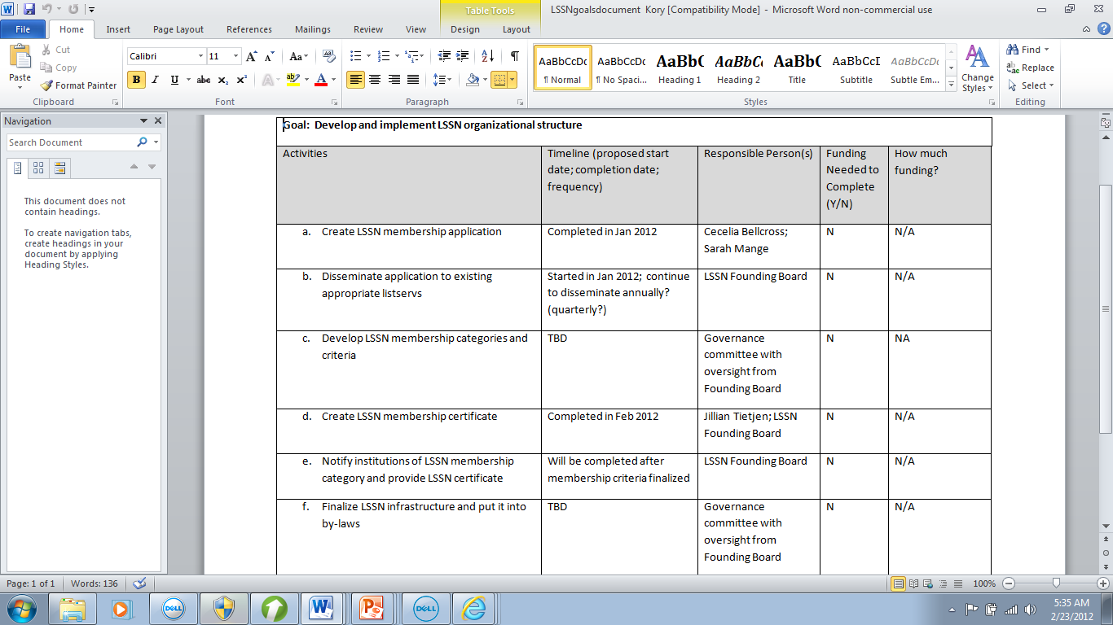
LSSN DRAFT GOVERNANCE GOAL

